Slide 1
Ethereum Blockchain
Founder: Vitalik Buterin
Currency : Ether (ETH)

Slide 2
Ethereum Components
Miner and Mining nodes
Ethereum Virtual Machine
Ether
Gas
Transactions
Accounts
Swarm and Whisper
Ethash

Slide 3
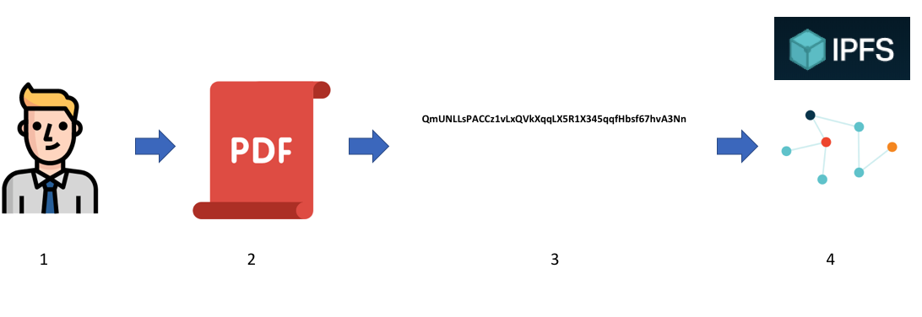
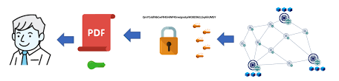
Miner and Mining nodes
Storing data in IPFS

Slide 4
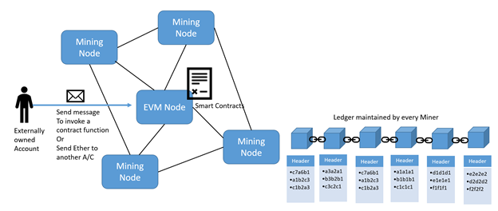
Two types of mining nodes:
Mining node
EVM
Port number: 30303
Functions of mining nodes:
Mine or make a fresh block together with the transactions and then compose the same into Ethereum ledger
Promote and send a recently mined block to other miners
Accept new blocks created by other miners and maintain them in the ledger

Slide 5
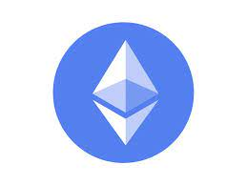
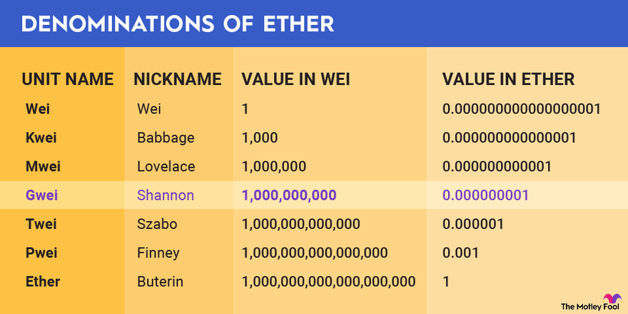
Ether:

Slide 6
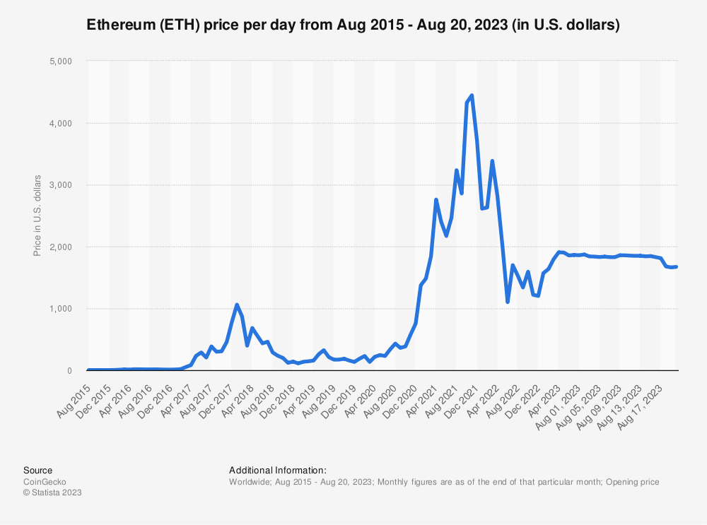
Growth of Ether

Slide 7
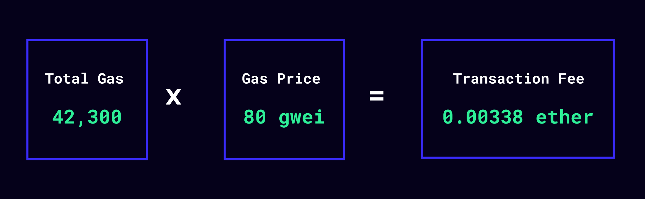
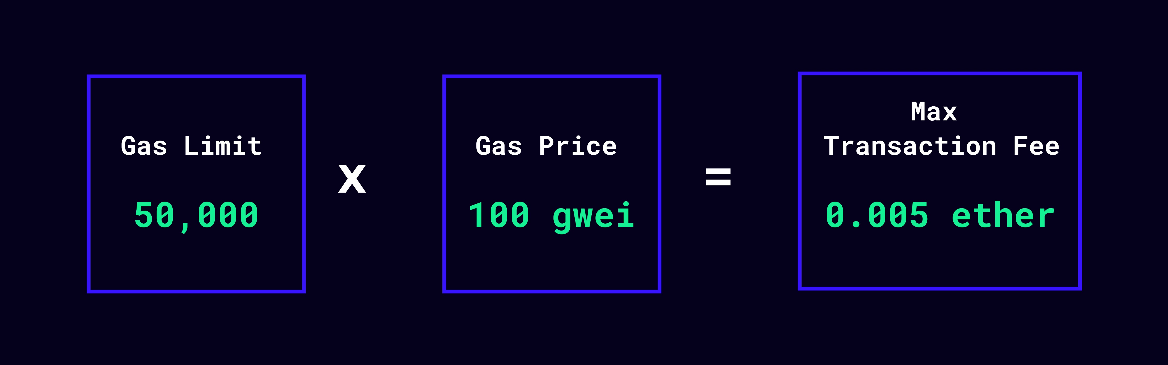
Gas:
Internal currency of Ethereum
Execution and resource utilization costs paid in Gas units
Every computation or transaction made on the blockchain costs some fees.
These fees prevent expensive (or endless) contract executions, ensure miners are fairly compensated for the work they do, and provide a fair market to prioritize which transactions make it onto the blockchain.
Gas Price
Gas Limit

Slide 8
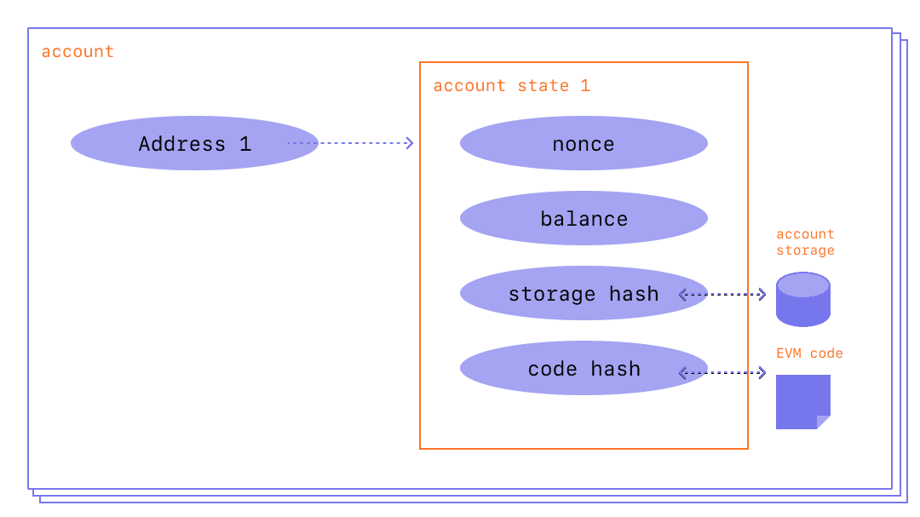
Transactions in Ethereum:
etherscan.io
Ethereum accounts:
Externally owned accounts (EOA)
Contract accounts (CA)

Slide 9
Swarm:
Peer-to-peer document sharing platform, incentivized with micropayments of ETH.
File records are divided into small chunks, dispersed, and stored with volunteers.
The nodes are paid with ETH from people using the information.
Whisper:
An encrypted messaging protocol that enables nodes to send out messages directly to each other, in a secure way.
Hides sender and receiver identity from the third party snoopers.
Ethash:
Proof-of-work algorithm that is modified variant of a precursor algorithm called Dagger-Hashimoto.
Ommer block:

Slide 10
Ethereum Architecture
Layer 5: DApps
Layer 4: Browser
Mist, Maelstorm, Omni Wallet
Layer 3: Interoperability
Layer 2: Blockchain Services
Smart Contracts, Time Stamping, IPFS
Layer 1: Economic Layer
Independent Tokens
Layer 0: Consensus Layer

Slide 11
 | Bitcoin | Ethereum
Founder | Satoshi Nakamoto | Vitalik Buterin and team
Purpose | Cryptocurrency | Network software
Release date | January, 2009 | July, 2015
Scripting language | Turing incomplete | Turing complete
Coin release method | Early mining | Through ICO
Average block time | 1appro. 10 min | Approx. 15 seconds
Transaction model | UTXO | Account
Coin symbol | BTC | ETH
Tokens | Not available | Available
Monetary policy | Hardcoded | Not hardcoded
Emission rate | Halving policy followed | Occasional
Backward compatibility | Available | Not available
Block limitation | 1MB per block | No limit
Currency mining limit | 21 million | No limit

Slide 12
Ethereum Test Networks
Networks can be divided into three types, based on the requirements and usage.
Mainnet
Testnets
Private nets
The mainnet
The mainnet is the current live network of Ethereum. Its network ID is 1 and its chain ID is also 1.
The network and chain IDs are used to identify the network.
Testnets
An Ethereum testnet is a collection of nodes that are used to test the Ethereum protocol. Tests are run on the testnets to ensure that the protocol is working as expected.
There are a number of testnets available for Ethereum testing.
The aim of these test blockchains is to provide a testing environment for smart contracts and DApps before being deployed to the production live blockchain.
Moreover, being test networks, they also allow experimentation and research.
The main testnet is called Ropsten

Slide 13
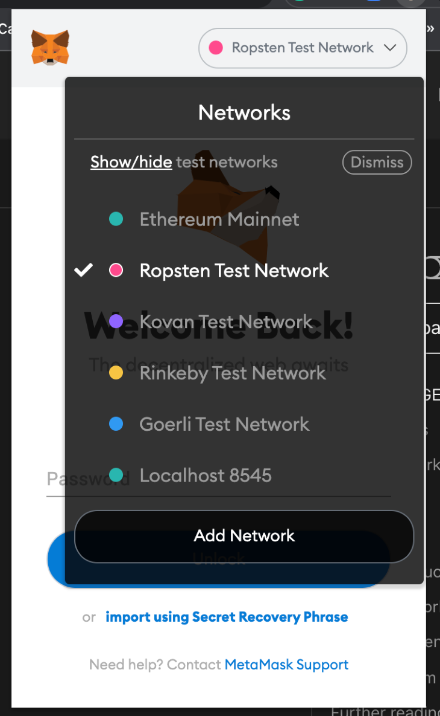

Slide 14
Rinkeby
Rinkeby is an Ethereum testnet that is used to test the Ethereum protocol.
It is a fork of the Ethereum mainnet.
Rinkeby enables you to develop your DApps in a test environment before deploying to the real Ethereum mainnet.
Built in April 2017 by the Ethereum Foundation and is maintained by the Geth developer team.
It uses the proof-of-authority consensus mechanism.
3 Eth- 8 hours, 7.5 Eth – 1 day, 18.5 Eth- 3 days
Kovan
Aanother testnet that is used to test the Ethereum protocol.
Like Rinkeby, Kovan is a fork of the mainnet.
Kovan was built in June 2017 by the Ethereum Foundation and, also like Rinkeby, is maintained by the Geth developer team.
It uses the proof of authority consensus mechanism as well.
You can write ERC-20, ERC-721, and ERC-1155 tokens on the Kovan testnet.
1 kEth per 24 hours

Slide 15
Ropsten
Another testnet that is used to test the Ethereum protocol.
Ropsten was built in August 2017 by the Ethereum Foundation and, also like Rinkeby, is maintained by the Geth developer team.
It uses the proof of work consensus mechanism.
You can write ERC-20, ERC-721, and ERC-1155 tokens on the Ropsten testnet.
The advantage of using Ropsten compared to other testnets is that it is the testnet that most faithfully emulates the Ethereum mainnet.
Its consensus algorithm is same as the Ethereum mainnet.
In addition, getting free Eths on Ropsten is easier than on other testnets.
0.3 Eth
Goerli
Was created in November 2018 by the Parity team.
Uses the proof of authority consensus mechanism.
The Goerli website displays the latest blocks and transactions, as well as ERC-20, -721, and -1155 tokens.
0.05 GÖETH.

Slide 16
Sepolia:
Sepolia Testnet was initially launched in 2021 as a closed testing environment running the Proof of Work (POW) consensus mechanism. However, it has transitioned with the main network into a public testnet and running the Proof of Stake (POS) consensus mechanism following the Merge in September 2022
You can obtain test Ethereum tokens for the Sepolia test network from the official faucet and a handful of other independent faucets.
Sepolia ETH is only meant for testing applications deployed on the network and pending final deployment on the main network. They are not meant to be traded.
Alchemy offers faucet service for Ethereum’s Goerli and Sepolia testnets. Alchemy remits up to 0.5 Sepolia ETH daily. In order to mitigate abuse, an Alchemy account is needed to access the faucet service.
Private nets
An Ethereum network is a private network if its nodes are not connected to a public network (i.e. Mainnet or a testnet).
In this context, private only means reserved or isolated, rather than protected or secure.
Helpful in development of networks

Slide 17
Ethereum Frameworks
Truffle — Most popular smart contract development, testing, and deployment framework. The Truffle suite includes Truffle, Ganache, and Drizzle.
Embark — Framework for DApp development
Waffle — Framework for advanced smart contract development and testing, small, flexible, fast (based on ethers.js)
Dapp — Framework for DApp development, successor to DApple
Populus — The Ethereum development framework with the most cute animal pictures
Etherlime — ethers.js based framework for Dapp deployment
Parasol — Agile smart contract development environment with testing, INFURA deployment, automatic contract documentation and more. It features a flexible and unopinionated design with unlimited customizability
0xcert — JavaScript framework for building decentralized applications

